Slide 1
Go to stjv.org. Click “Donate”. Then click “View Donor Portal
Enter an amount here.
Or click here to create or access your account.

Slide 2
Donor Portal
New users click here
Login here if you have an existing account.

Slide 3
Fill out your basic information to create an account.

Slide 4
Enter your payment information here.
Visa, Mastercard, and American Express are accepted, or you click on the “Use Check” image to link to your bank account.

Slide 5
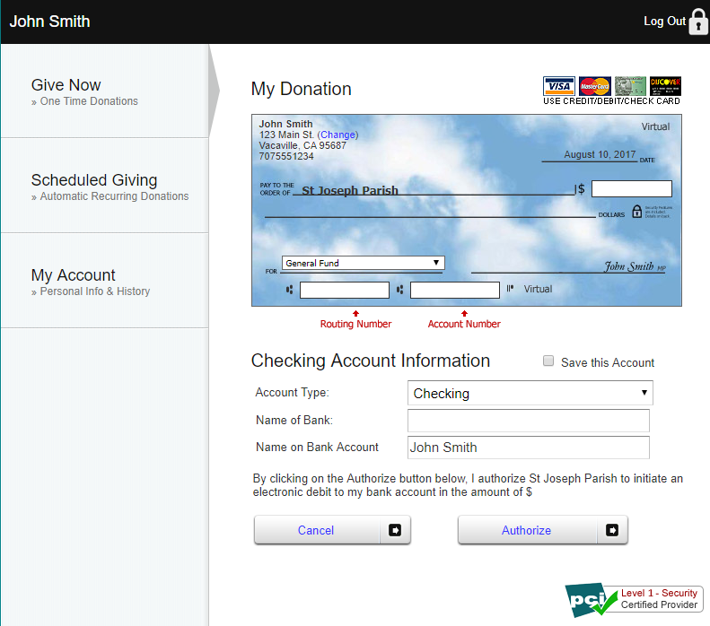
Fill out your information as it appears on your checks, along with your name and the name of your bank.

Slide 6
You can choose which fund to give to when making any donation.

Slide 7
Under “Scheduled Giving” you can arrange for your donation to be paid automatically on a regular schedule - - monthly, twice a month, weekly, or bi-weekly - - whatever works best for you.

Slide 8
Go to “My Account” to update your personal information and view your giving history.

Slide 9
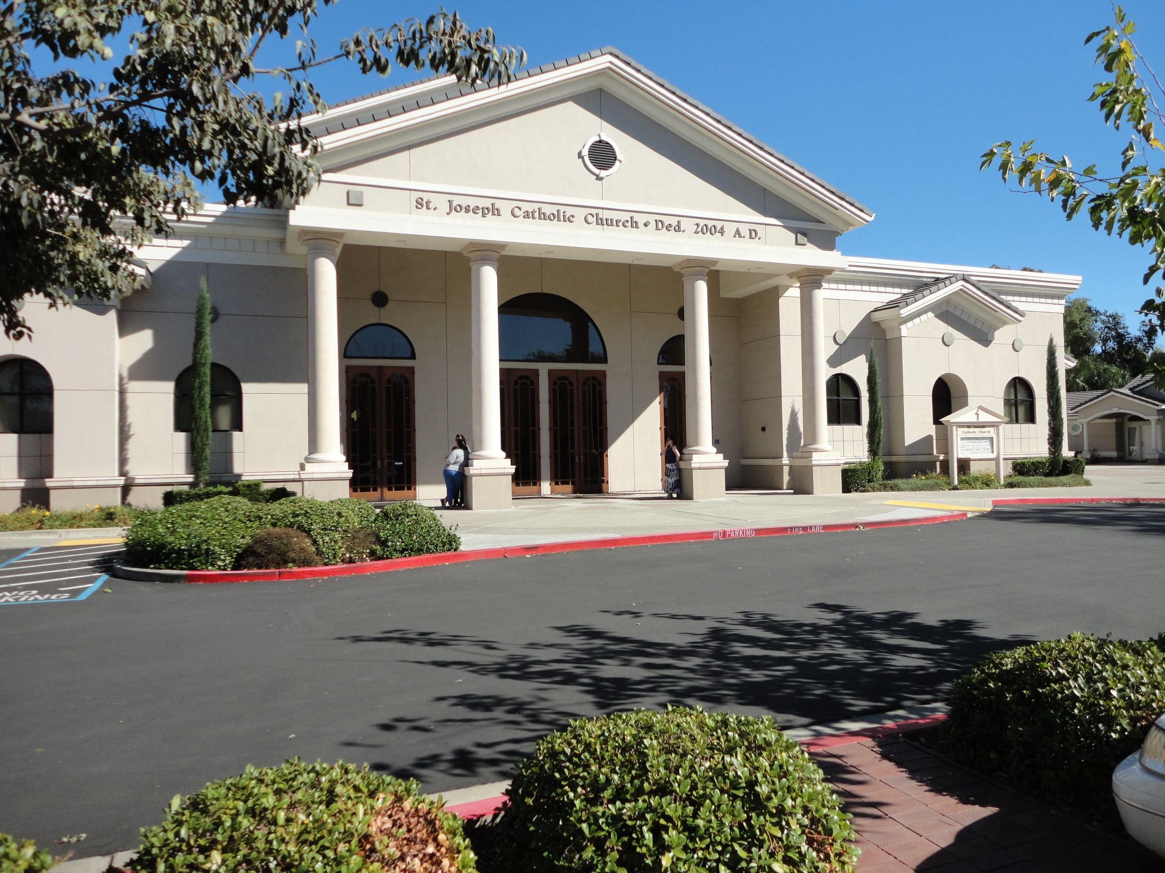
That’s it! You can now donate online with ease.
Thank you for your stewardship of St. Joseph Parish.

